Slide 1
Lending Club Loan Analysis
It’s like Las vegas with slightly better odds of getting your money back
Amir Vasquez
Narjes Taqvaei
Tolga Caglar
Kevin Mickey

Slide 2
Background
Lending Club facilitated peer-to-peer loans. (Loans between a group of investors and a pool of borrowers)
They charged fees to both investors and borrowers. Borrowers also paid interest on the loans
Loans were short term. Usually 36 or 60 months
Similar to Patreon/Gofundme, but with expectation of cash repayment vs services, products or charity.
Changed business model in 2020, bought a bank and elimited individual investors

Slide 3
Data
2007 through Q3 2020 in CSV format
1.77GB, 152 columns and 2,925,492 rows
Reduced the data set to 39 relevant columns. Additionally deleted any columns missing more than 30% entries
Final size 870MB

Slide 4
Data Cleanup
Convert objects to float examples
The interest rate column was a string in <xx.x%> format. Loan length in <xx Months>
Had to delete the %, then convert the remaining string number into a float, similar for Loan Length
Dates were also string objects.
All were in <MMM-YYYY> format so easy to convert to a datetime object
The resulting DT object defaulted to the first of that month in DD-MMM-YYYY format
NAN Values – Replaced with the mean of that column. Otherwise ML breaks

Slide 5
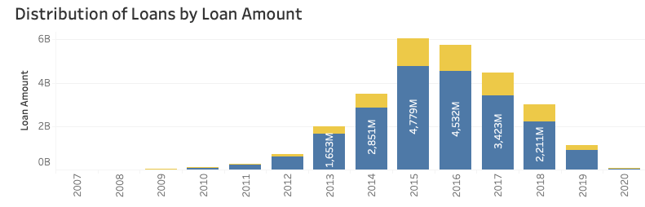
The rise and fall of Lending Club
Lending Club was caught cooking the books in 2016-17 and fired top executives

Slide 6
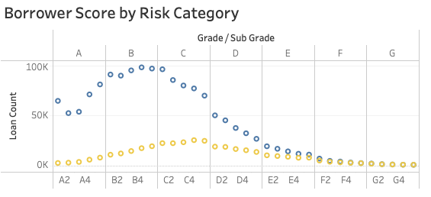
Loan origination vs Borrower FICO score
There is a clear dropoff of loan approval at the C5-D1 grade
If you back a E or lower loan you are in 50-50 territory

Slide 7
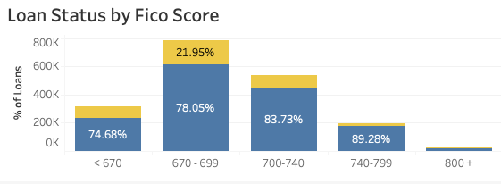
Repayment vs Fico score
The higher the score, the more likely to be repaid
Less than 670 had most defaults at 25%

Slide 8
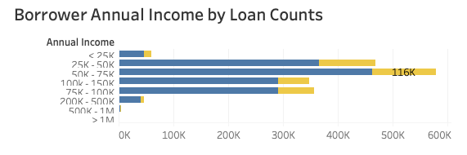
Income vs loan requests
Not surprisingly, Lending Club doesn’t do much business at the high or low end of the scale, focusing on the $25-150K range

Slide 9
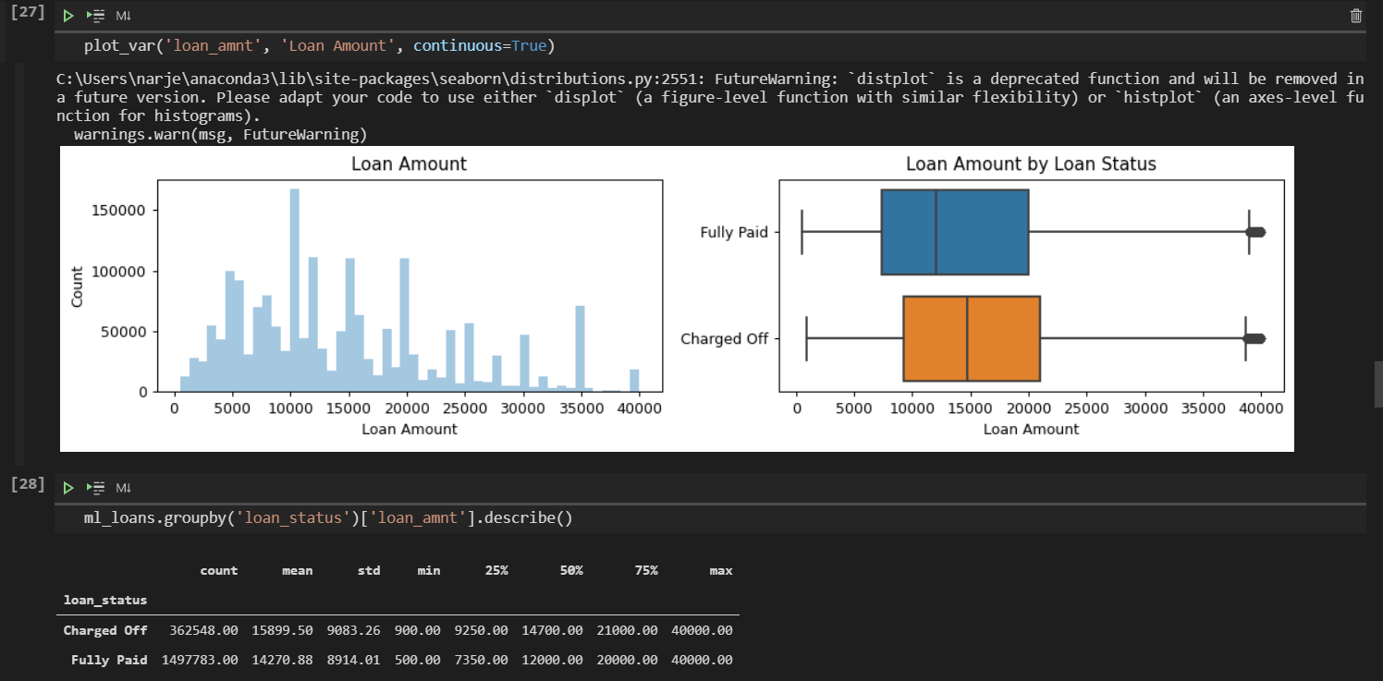
Machine learning
Unbalanced data set
80% fully paid
20% charged off (defaulted)
Need to determine which features (columns) are most important to ML

Slide 10
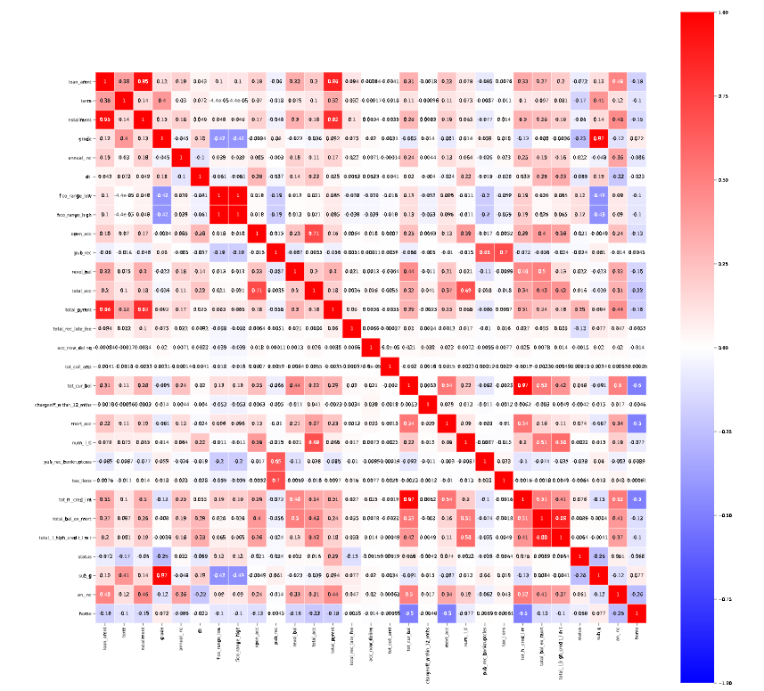
Correlation between variables
Our remaining fields produce the following
Interest rate vs Grade
Loan amount vs monthly payment
Use this to determine 10 features to test in ML

Slide 11
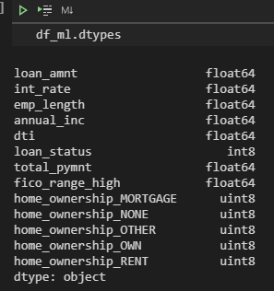
Final category list
There was more data conversion performed here
The Mortgage field was converted from an array to separate fields which count each mortgage type
Loan status converted to 1 or 0

Slide 12
Random Forest Imbalanced data
Confusion Matrix: a table showing correct predictions and types of incorrect predictions.
Precision: the number of true positives divided by all positive predictions. Precision is also called Positive Predictive Value. It is a measure of a classifier’s exactness. Low precision indicates a high number of false positives.
Recall: the number of true positives divided by the number of positive values in the test data. Recall is also called Sensitivity or the True Positive Rate. It is a measure of a classifier’s completeness. Low recall indicates a high number of false negatives. 99.91%
F1: Score: the weighted average of precision and recall. 98.64%

Slide 13
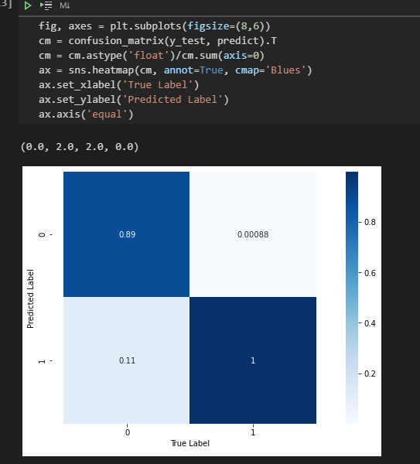
Confusion matrix: Imbalanced data
The diagonal elements represent the number of points for which the predicted label is equal to the true label, while off-diagonal elements are those that are mislabeled by the classifier. The higher the diagonal values of the confusion matrix the better, indicating many correct predictions.
.89, .00088 .11, 1

Slide 14
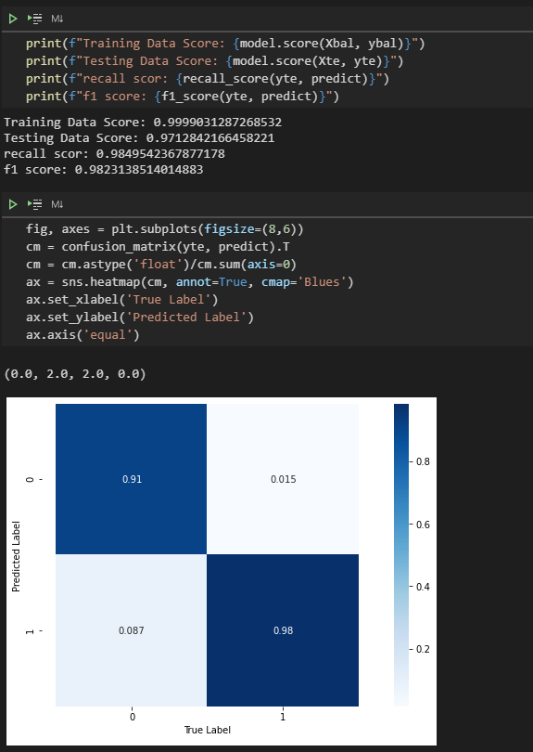
Confusion Matrix: Balanced data (equal loan status)
.91, .015 .087, .98

Slide 15
Conclusion
Linear Discriminant Analysis – 89.2%
Random Forest Classifier – 78.2%
Logistic Regression – 94.9%
Multinomial NB – 93.9%

Slide 16
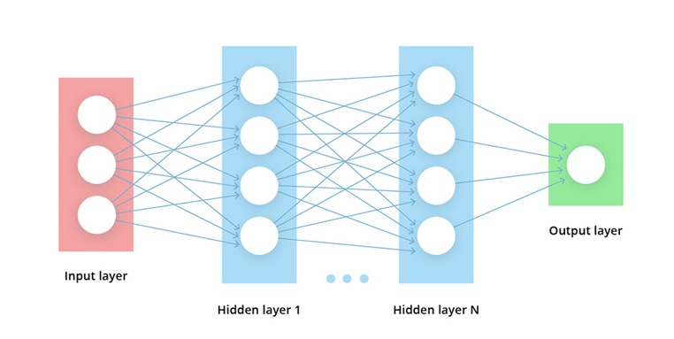
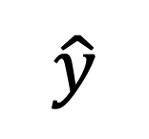
Deep learning performance for larger number of inputs
N=2 hidden layers with Relu activation. Weights are calculated from the binary crossentropy loss
$$\hat{y}$$

Slide 17
Actual
Performance measurements for imbalanced data:
Precision: 88%
Accuracy: 89%
Charged Off
Fully Paid
13,000 (88%) | 1,670 (12%)
1,600 (3%) | 67,000 (97%)
Charged Off
Predicted
F1 score: 89%
Fully Paid
Compared to random forest, this is a poor performance.
➔ Deep network is not necessarily a good choice when small number of features are sufficient.

